Slide 1
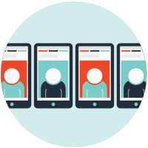
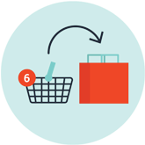






Why Magento?
Open, Flexible Architecture Powered by an entirely new, next-generation architecture, it provides unparalleled flexibility to bring your commerce vision to life.
Engaging Shopping Experiences Central to the platform is an engaging, seamless and personalized customer experience across any device.
Customer Segmentation, Targeted Promotions &
Merchandising
Content Management System
Dynamic Rule Based Product Relations
Rewards Points
Store Credits
Multiple Wish Lists
Return Management Authorization (RMA)
Marketing, Promotions and Conversion Tools
Search Engine Optimization
Catalog Management
Catalog Browsing
Product Browsing
Checkout, Payment and Shipping
Order Management
Customer Accounts
International Support
Customer Service
Analytics and Reporting
Mobile HTML5 (pre-integrated)
Responsive Design
Scheduled Import/Export Functionality
Backup and Rollback
Staging, Merging and Rollback of Content
PA-DSS Certification/Payment Bridge
Strong Data Encryption, Hashing and Key Management
Solr/Elastic Search integration
Logging of Administrator Actions
Enhanced Business Agility and Productivity Magento 2.0 empowers merchants by providing a more efficient experience that facilitates rapid growth.
Attract & Engage Built-in SEO and fully customizable to attract and engage customers with rich, differentiated experiences.
Secure Payments Security is a key component, with tight out-of-the-box with PayPal, Braintree, and Authorize.net payment gateways.
Drive Loyalty Ensure a smooth post-purchase experience with order management tools. Turn customers into loyal advocates with rewards, wish lists, gift registries and more.
Easier Maintenance and Upgrades An overhauled, modern and modular architecture empowers the functionality provided by Magento 2, providing unsurpassed scope and flexibility.
Enterprise-grade Scalability and Performance Featuring over 50% faster page load speeds across catalog and checkout pages, performance lies at the heart to enhance the customer experience and improve conversion rates.

